Slide 1


Slide 2
What is ANDROID?
Google’s Android is an open-source and Linux-based Operating System
For smartphones and tablet computers
Developed by the Open Handset Alliance
The Android SDK provides the tools and APIs necessary to begin applications on the Android platform using the Java programming language

Slide 3
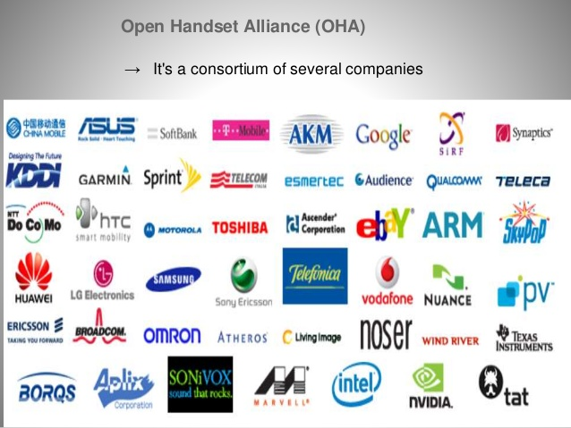
Open Handset Alliance

Slide 4
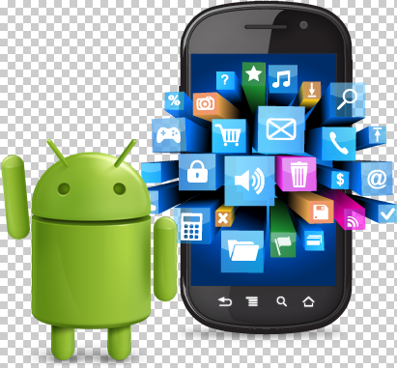
Features
Beautiful UI
Connectivity
SQLite is used for storage
Multi-tasking
Messaging

Slide 5
Android API
Name | Version Number | API Level
No name | 1.0 | 1
Petit Four | 1.1 | 2
Cupcake | 1.5 | 3
Donut | 1.6 | 3
Eclair | 2.0 - 2.1 | 5-7
Froyo | 2.2 - 2.2.3 | 8
Gingerbread | 2.3 - 2.3.7 | 9-10
Honeycomb | 3.0 - 3.2.6 | 11-13
Ice-cream Sandwich | 4.0 - 4.0.4 | 14-15
Jelly Bean | 4.1 - 4.3.1 | 16-18
KitKat | 4.4 – 4.4.4 | 19
Lollipop | 5.0 - 5.1.1 | 21-22
Marshmallow | 6.0 – 6.0.1 | 23
Naugat | 7.0-7.1.2 | 24-25
O | 8.0 | 26

Slide 6
Key Terms
SDK(Software Development Kit): A set of tools and libraries that allow the user to create an application based on a product.
IDE(Integrated Development Environment): A software application that consists of a source code, editor, a compiler, build automation tools and a debugger. It makes programming and running application easier.
ADT(Android Development Tools): A plugin for eclipse that extends the Eclipse IDE by providing more tools to develop Android Applications.
AVD(Android Virtual Device): An android emulator that allows to simulate how the application will run on an actual android device.
JDK(Java SE Development Kit): A popular Java SDK that is used to program Android Application.

Slide 7
Tools
Phone
Eclipse
Android SDK
Windows Users

Slide 8
Creating Your First Android App
Setup the development environment
Create a new Android project in Eclipse
Run the created project in the emulator

Slide 9
1. Setup the development environment
Install Eclipse
Install Android SDK (Android libraries)
Install ADT plugin (Android Development Tools)
Create AVD (Android Virtual Device)

Slide 10
2. Create an Android Project in Eclipse
File → New → Project
Select “Android Project”
Fill in the Project details
Finish

Slide 11
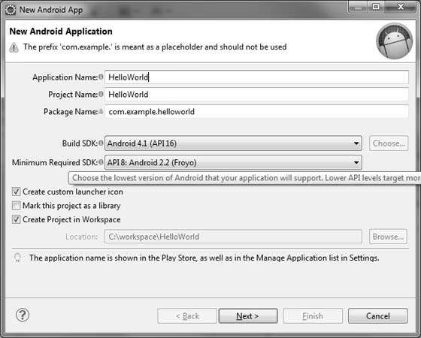
Name that appears
on device
Directory
name
Android
version
Java package

Slide 12
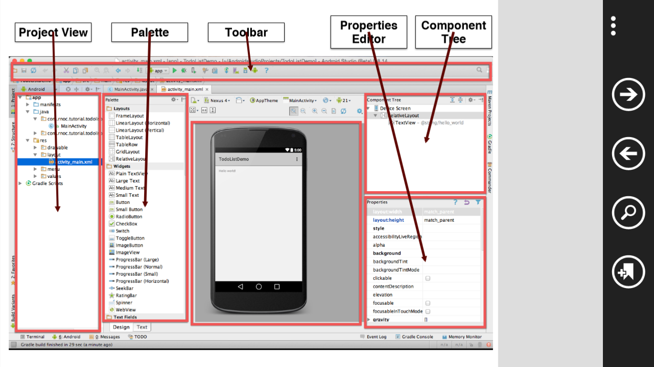
Once the project is created successfully, you will have following project screen:

Slide 13
Few directories and files in the Android Project:

Slide 14
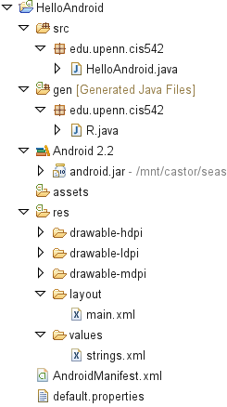
Source
code
Auto-generated
code
UI
layout
Configuration

Slide 15
Main Source Code
The main activity code is a Java file MainActivity.java.
This is the actual application file which ultimately gets converted to a executable and runs your application.

Slide 16
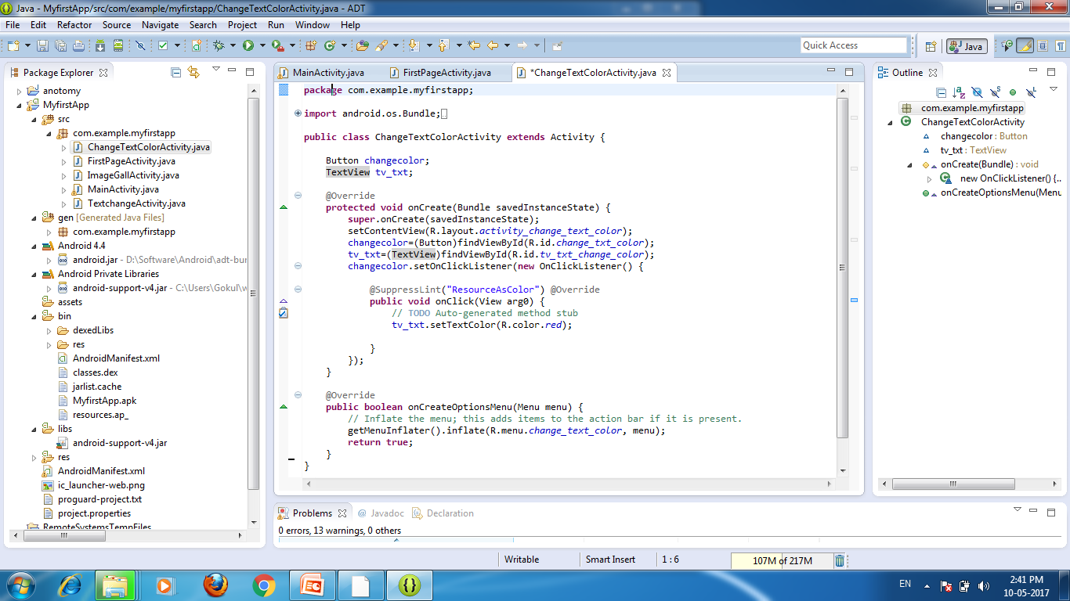
The Main Activity File

Slide 17
Auto generated file
It is also called as R.java file
This file is auto generated file
Contains IDs of the project resources

Slide 18
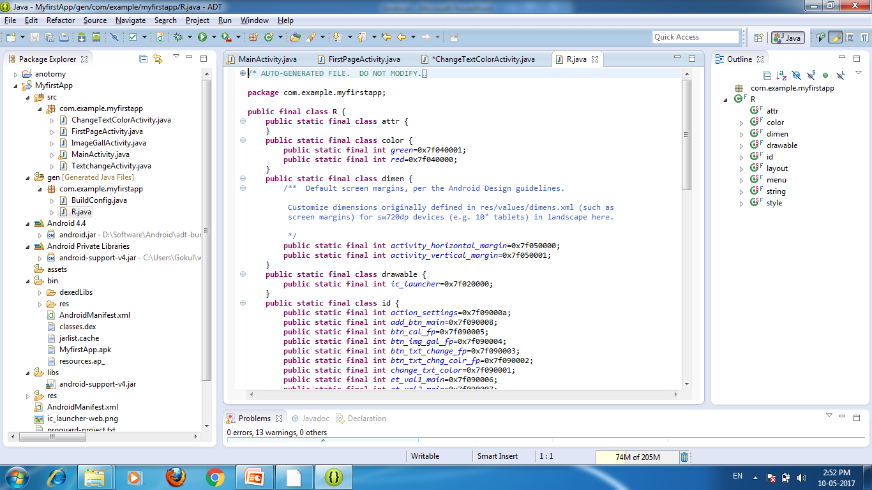
R.java File

Slide 19
Layout Directory
Eclipse has a great UI creator
Composed of View Objects
Can be specified for portrait and landscape mode

Slide 20
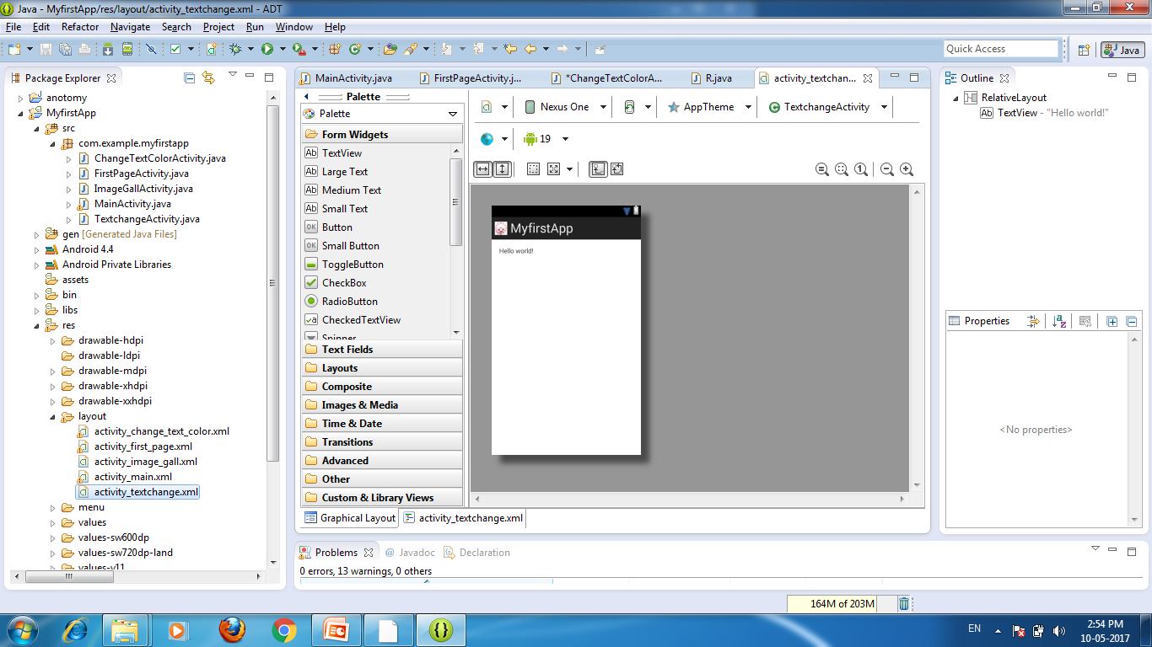
Layout Directory

Slide 21
3. Run the created project in the emulator
You had created an AVD while doing environment setup.
To run the app from Eclipse, open one of your project's activity files and click Run icon from the toolbar.
Eclipse installs the app on AVD and starts it and if everything is fine with setup and application.
It will show the following window:

Slide 22
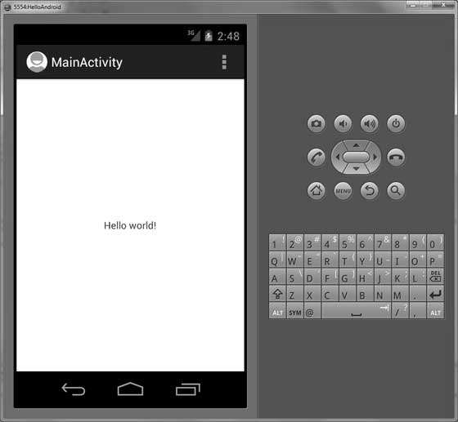

Slide 23
LETS START WITH OUR FIRST PRACTICAL!!!

